Slide 1
Java
Sijo

Slide 2
Introduction
Simple
Object oriented
Distributed
Multithreaded
Dynamic
Architecture neutral
Portable
High performance
Robust
Secure

Slide 3
Get started quickly:
Java programming language is a powerful object-oriented language, it's easy to learn, especially for programmers already familiar with C or C++.

Slide 4
Differences bw C and JAVA
C
JAVA
Prodcedural
Compiled
NO OOPS
top-down {sharp & smooth} approach
User Defined Memory Management
Pointers
NO Exception Handling
Object-Oriented
Interpreted language
OOPS language
bottom-up {on the rocks} approach.
Behind-the-scenes Memory Management
NO Pointers
Exception Handling

Slide 5
JAVA environment
JAVA compiler (compiled and Interperted)
Java Virtual Machine (software in your System
Java API(Collection of classes and Interfaces)

Slide 6
Syllabus for core JAVA
Application
Control Statements
Arrays and Strings
Class Concepts
Inheritance
Interface and package
Exception Handling
Streams
Thread
Networking
JDBC

Slide 7
Syllabus for Advanced JAVA
Applet
Collection
Swings
JDBC
HTML, JavaScript
Servlets
JSP(Introduction basics)

Slide 8
Four types of Architecture
1. Single Tier -> Foxpro (Single User)
2. Two Tier (or) Client/Server Technology-> VB and Oracle (Multi user)
3. Three Tier -> HTML, ASP, Oracle

Slide 9
First Hello world
class first {
public static void main(String args[]) {
System.out.println("My First Java Program");
}
}
java class name and the filename may be same
**explanation of psvm

Slide 10
primitive datatypes
Type Size Range
---- ----- ------
byte 1 byte(2^7) -128 to +127
short 2 bytes(2^15) -32,768 to +32,767
int 4 bytes(2^31) -2,147,483,648 to +2,147,483,647
long 8 bytes(2^73) 9223372036854775808 to
char 2 bytes (Universal Code)
float 4 bytes - 3.4e38 to + 3.4e38
double 8 bytes -1.7e308 to +1.7e308

Slide 11
Type casting
Implicit(widening) (compiler itself does it)
Int x=‘a’;
Sop(x)
Explicit(Narrowing )(Programmer has to do it)
Int i=90;
Short s=(Short)i

Slide 12
Variables(local and Global)
1. Instance variable
Instance variables are used to define attributes or the state of particular object.
2. Local variable
Local variables are used inside blocks as counters or in methods as temporary variables.
3. class variable
class variables are global to a class and to all the instances of the class

Slide 13
Operators
Arithmetic + - * / %
Relational >, <, >=, <=, ==, !=
Logical &&, ||, !
Increment and Decrement ++,--
Conditional ?:
Assignment =
Bitwise &, |, ^, <<, >>
Arithmetic Assignment +=, -=, *=, /=, %=

Slide 14
Conditional statements
if statements
switch case
while loop while(true) while(1)
do while
for for(;;)
break;

Slide 15
if
public class Test {
public static void main(String args[]){
int x = 10;
if( x < 20 ){
System.out.print("This is if statement");
}
}
}

Slide 16
If else
public class Test {
public static void main(String args[]){
int x = 30;
if( x < 20 ){
System.out.print("This is if statement"); }
else{
System.out.print("This is else statement");
}
} }

Slide 17
Nested if
public class Test {
public static void main(String args[]){
int x = 30;
int y = 10;
if( x == 30 ){ if( y == 10 ){
System.out.print("X = 30 and Y = 10");
}
}
} }

Slide 18
Switch
public class Test {
public static void main(String args[]){
//char grade = args[0].charAt(0);
char grade = 'C';
switch(grade) {
case 'A' : System.out.println("Excellent!"); break;
case 'B' : System.out.println("Excellent!"); break;
case 'C' : System.out.println("Well done"); break; case 'D' : System.out.println("You passed"); case 'F' : System.out.println("Better try again"); break; default : System.out.println("Invalid grade");
} System.out.println("Your grade is " + grade);
} }

Slide 19
While
class WhileDemo {
public static void main(String[] args){
int count = 1;
while (count < 11) {
System.out.println("Count is: " + count); count++; }
} }

Slide 20
Do while
class DoWhileDemo {
public static void main(String[] args){
int count = 1;
do {
System.out.println("Count is: " + count); count++; } while (count < 11); } }

Slide 21
OOPS CONCEPTS
1. Classes and Objects
Class -> Collection of member variables and member functions.
2.Inheritance Reusability of the code
3. Polymorphism One in many forms (run time and compile time)
4.Data Abstraction showing the required process and hiding the internal implementation
5.Data Encapsulation
Encapsulating or binding the data

Slide 22
Class
class class_name
{
access_specifier datatype var_name;
access_specifier return_type function_name(arguments);
}

Slide 23
Access Specifier
private -> With in a class
public -> Class, Subclass and main function(thru object)
protected -> Class and Subclass
no modifier -> similar to public ( Differed in package concept).
Note: By default, the variables and functions are no modifier.

Slide 24
Defining a Class Object
Class Sample{
Int a ,b;
Void fun(){
Statement1;
}
Class Main{
public static void main(String args[]){
Sample s=new Sample();
System.out.println(“a value is ”s.a);
s.fun1();
}
}

Slide 25
Passing arguments and returning values
Class Sample{
Int a=23;
Sample(){
Statementa;}
Sample(int w, int q){ return a;
Statemnet 2; return a;}
Sample(char e, int v){
Statement 3; return a;
}
Class Main{
public static void main(String args[]){
Sample s=new Sample(); Sample s=new Sample(23,23); Sample s=new Sample(‘r’,34);}}}

Slide 26
Passing object as arguments
Class Sample{
Int a;
Sample(){
Statementa;}
Sample(int w, int q){
Statemnet 2;}
Sample(Sample s){
Statement 3;
}
Class Main{
public static void main(String args[]){
Sample s1=new Sample(); Sample s2=new Sample(23,23); Sample s3=new Sample(s3);}}}

Slide 27
Function overloading
Class Sample{
Int a;
Void function1(){
Statementa;}
Class Sample23{
Int a;
Void function1();
}
Class Main{
public static void main(String args[]){
Sample s=new Sample(); s.fuction1();
Sample23 s23=new Sample23();
S23.function1();
}}}}}

Slide 28
Next topics
5. Constructor used to initialise resources in class
6. Finalizer
7. Static methods and variables. Variables are not reinitialized
8. Final keyword cannot change the value once initialised
9. Abstract Class class which has a abstract method

Slide 29
Constructor prg
Class Sample{
Int a;
Sample(){
Statementa;}
Sample(int w, int q){
Statemnet 2;}
Sample(char e, int v){
Statement 3;
}
Class Main{
public static void main(String args[]){
Sample s=new Sample(); Sample s=new Sample(23,23); Sample s=new Sample(‘r’,34);}}}

Slide 30
This keyword
Class Sample{
Int a,b,c;
String s;
Sample(int a;){
this.a=a;}
Sample(String s1){
this.s=s1;}}
Class Main{
public static void main(String args[]){
Sample s1=new Sample(); Sample s2=new Sample(23,23); Sample s3=new Sample(“sijo”);}}}

Slide 31
Super Keyword
Class Parent {
int a;
Void Parent (){
System.out.printf(“hi I am constructor of parent ”)}
Class Sub {
int a;
Void Sub (){
Super();
System.out.printf(“hi I am constructor of Sub ”)}
Class Main{
public static void main(String …args){
Sub s=new Sub();
Parent p=new Parent();
}}
}

Slide 32
Arrays
Its called arrays of arrays(Java)
for(i=0;i<3;i++){
for(j=0;j<3;j++){
int a[i][j]=new int[i][j];
}
}
a[0] =new int[3];
a[0][1]= new int[2];
a[0][2]=new Int[7];

Slide 33
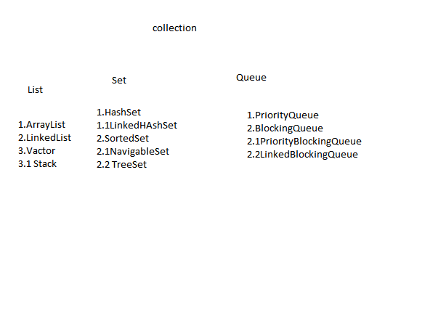
Collections

Slide 34
Program
ArrayList al()=new Arraylist();
ArrayList al()=new Arraylist(int capacity);
ArrayList al()=new Arraylist(collection c);
a .add(),,,,a.remove();….new capacity =(old*3/2)+1;
LinkedList al =new LinkedList();
LinkedList al =new LinkedList(nt capacity);
LinkedList al =new LinkedList(collection c);
l.add()…l.set(position,”object”),,,, l.removeLast();,,,,l.addFirst();
Vector v=new Vector();
v.add(int index, object o)…v.addElement(object o),,,remove(object o),,,removeElement(object o),,,remove(int obj)
Stack s new Stack();
s.push()……s.pop()…

Slide 35
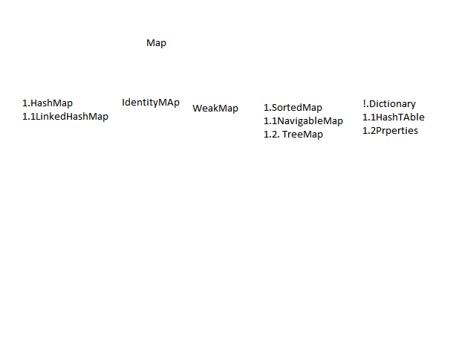
MAp

Slide 36
Threading
class Sample extends Thread{
public void run(){
for(int i=0;i<23;i++){
System.out.println(“hi”);
}
}
class Main(
public static void main(String args[]){
Sample s=new Sample();
s.start();
}}}}}

Slide 37
Threading Proirity
Sleep()
causes to sleep the thread for milliseconds
Join()
causes to wait the current thread and lets other same proirity thread to run
Wait()
waits until any thread notifies it
By dafault ---5,,, Maximum –10
High num have high proirity

Slide 38
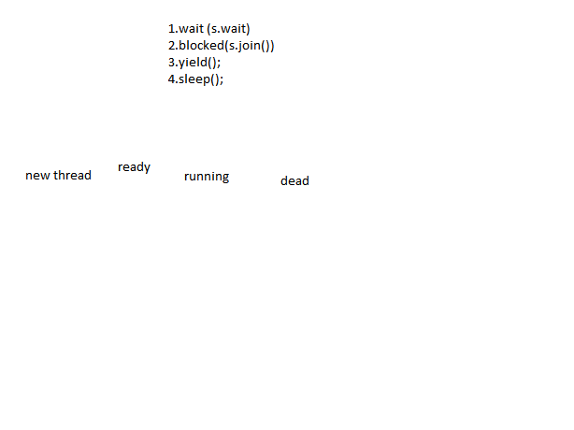
Thread Life Cycle

Slide 39
Exception and Error Handling
Arthematic Exception
ArrayIndexOutOfound Exception
ClassCast Exception
IlleggalArgument Exception
Number Format Exception
Illegal State Exception
IllegalThreadState Exception
IllegalMonitorState Exception
IndexOutOfBound Exception
InputOutPut Exception
FileNotFound Exception
EndOfFile Exception
InterruptedException Exception
Servlet Exception

Slide 40
Eception Programs
class Sample[
Public static void main(){
try{
c=a+b;
System.out.println(“sijo”);
}
Catch(Exception e){
System.out.println(e);
}
finally{
Syste.out.println(“this will be execeuted anything may happen”);
}

Slide 41
Java Capabilities
Web Dynamic environment
Mobiltiy(Android ,BlackBerry,UI)
Cloud
Big Data
Network Security apps
Games
Animation Softwares

